Slide 1



DDT: Mitigating the Competitiveness Difference of Data Center TCPs
Tao Zhang¹, Jiawei Huang¹, Shaojun Zou¹, Sen Liu¹, Jinbin Hu¹, Jingling Liu¹, Chang Ruan¹, Jianxin Wang¹, Geyong Min²
¹ Central South University, China
² University of Exeter, UK
3rd Asia-Pacific Workshop on Networking (APNET 2019) August 17-18 2019, Beijing, China
Notes:
Mr.Chairman, Honorable guest, Ladies and gentlemen, good morning,
it's very pleasure for me to attend this meeting.
Today I would like to present my paper“DDT: Mitigating the Competitiveness Difference of Data Center TCPs”.

Slide 2
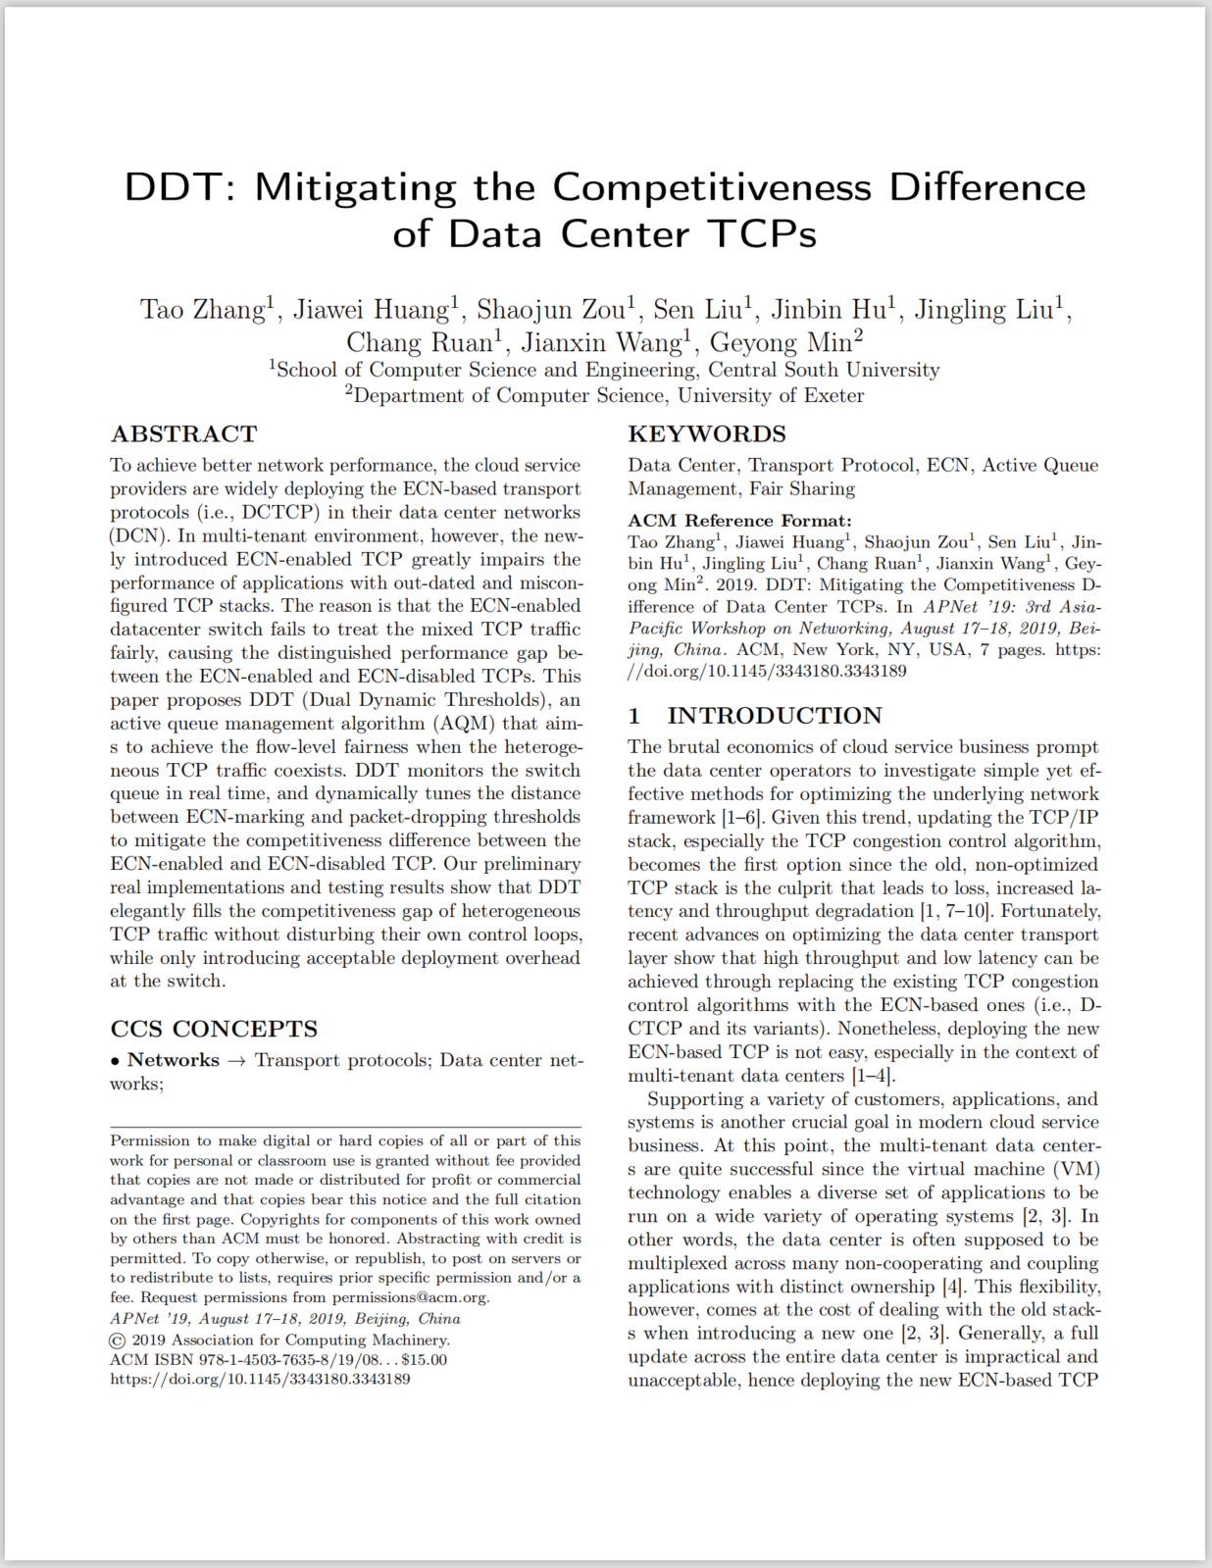
Outline
Background
Motivation
Coexistence problem
Possible remedies
Objectives
Approach
Basic idea
DDT algorithm
Evaluation
Small-scaled real implementation
Large-scaled simulation
Conclusion
3rd Asia-Pacific Workshop on Networking (APNET 2019) August 17-18 2019, Beijing, China
Notes:
This is the outline of my talk.
Firstly, I'm going to introduce the research background.
Secondly, I'll elaborate the motivation and describe our approach.
Then, the evaluation results will be presented.
Finally, I'll summarize our work.

Slide 3
Background
3rd Asia-Pacific Workshop on Networking (APNET 2019) August 17-18 2019, Beijing, China
Notes:
We start with introducing the background.

Slide 4
Background
Data Center transport should meet the requirement of
“high throughput and low latency”.
3rd Asia-Pacific Workshop on Networking (APNET 2019) August 17-18 2019, Beijing, China
Notes:
In the context of data center transport, there is an old, but endless problem, which is how to use simple but effective method to achieve both high throughput and low latency.

Slide 5
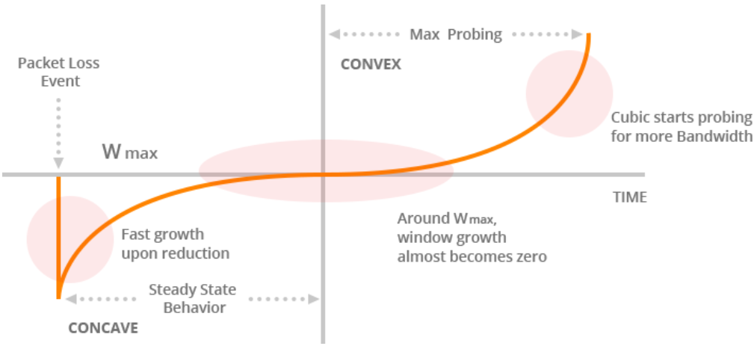
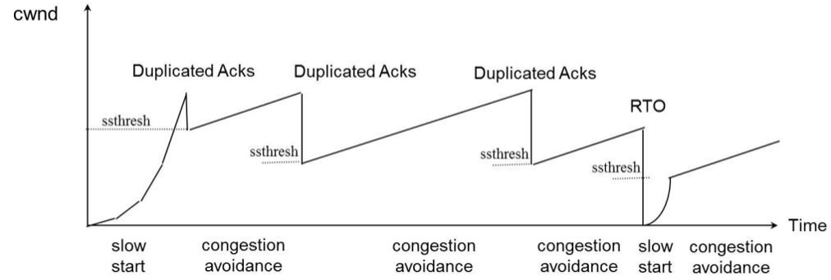
Background
drop-based CUBIC
drop-based Reno
Old TCPs
3rd Asia-Pacific Workshop on Networking (APNET 2019) August 17-18 2019, Beijing, China
Notes:
However, the old, non-optimized TCP stack is the culprit that leads to loss, increased latency and throughput degradation.
Therefore, for the consideration of practicability, updating the existing congestion control algorithm in TCP/IP stack becomes the first option.

Slide 6
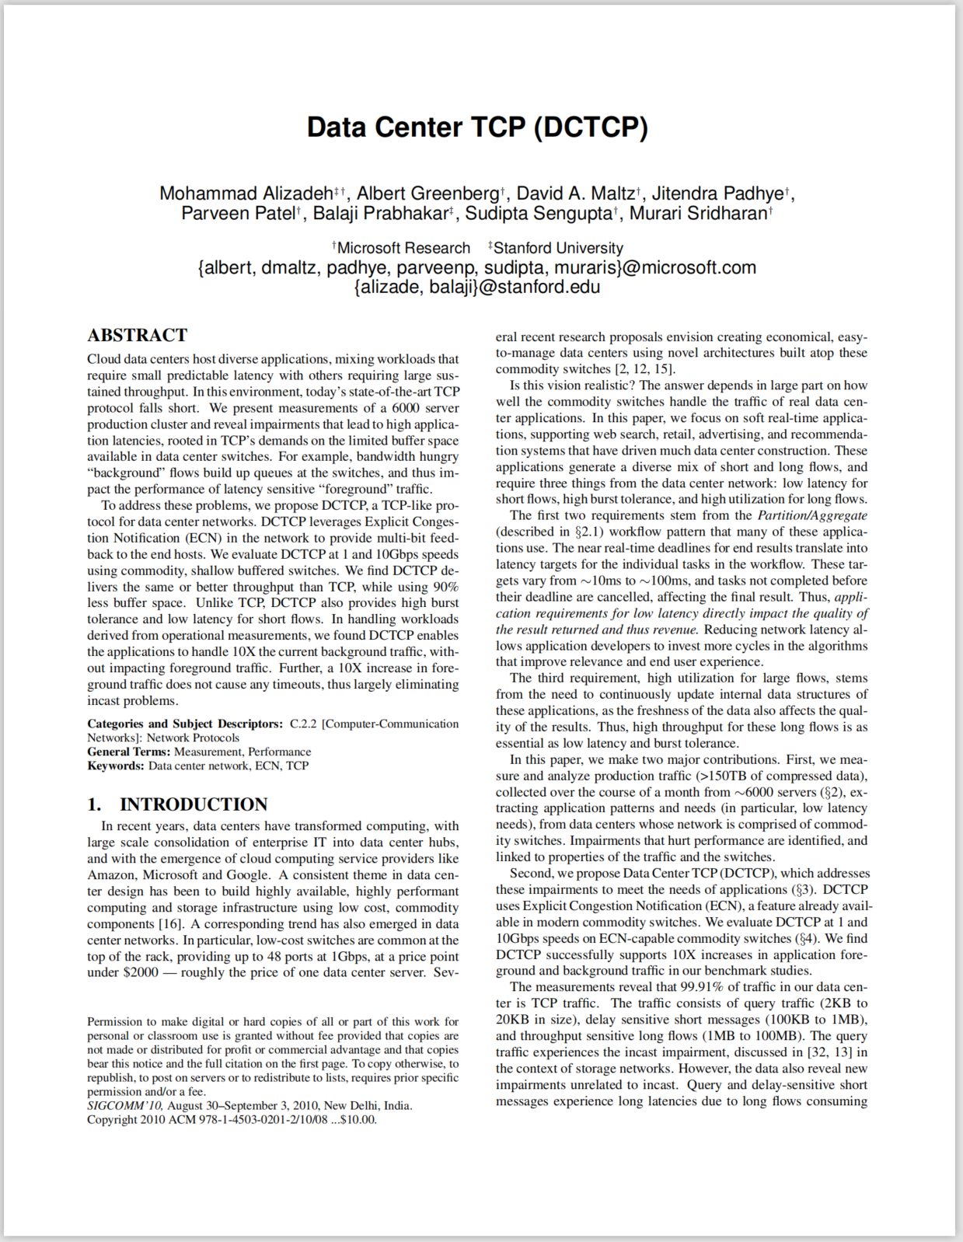
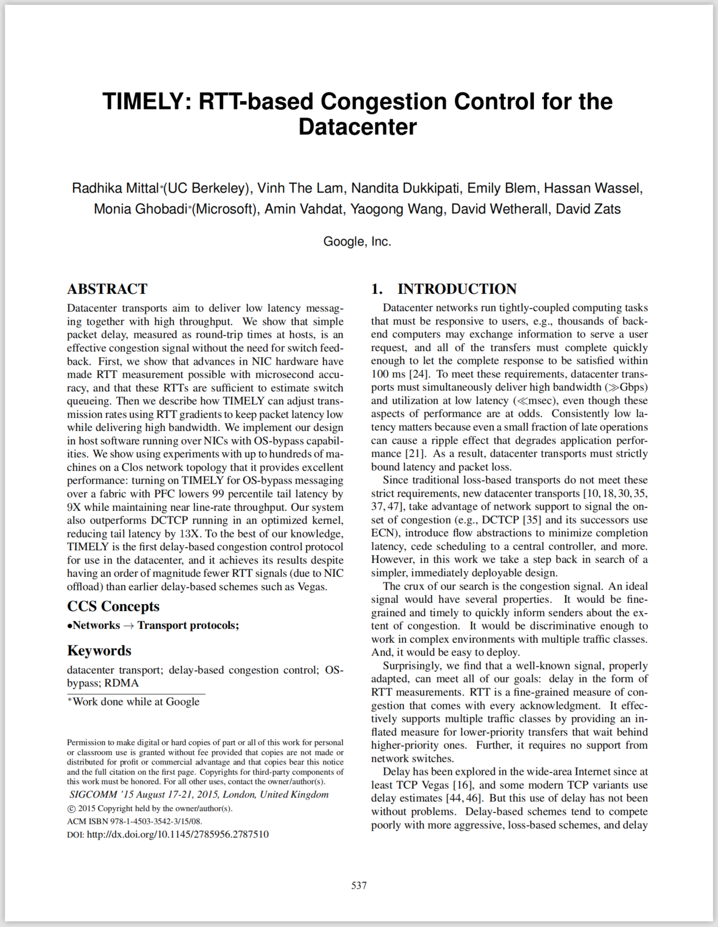
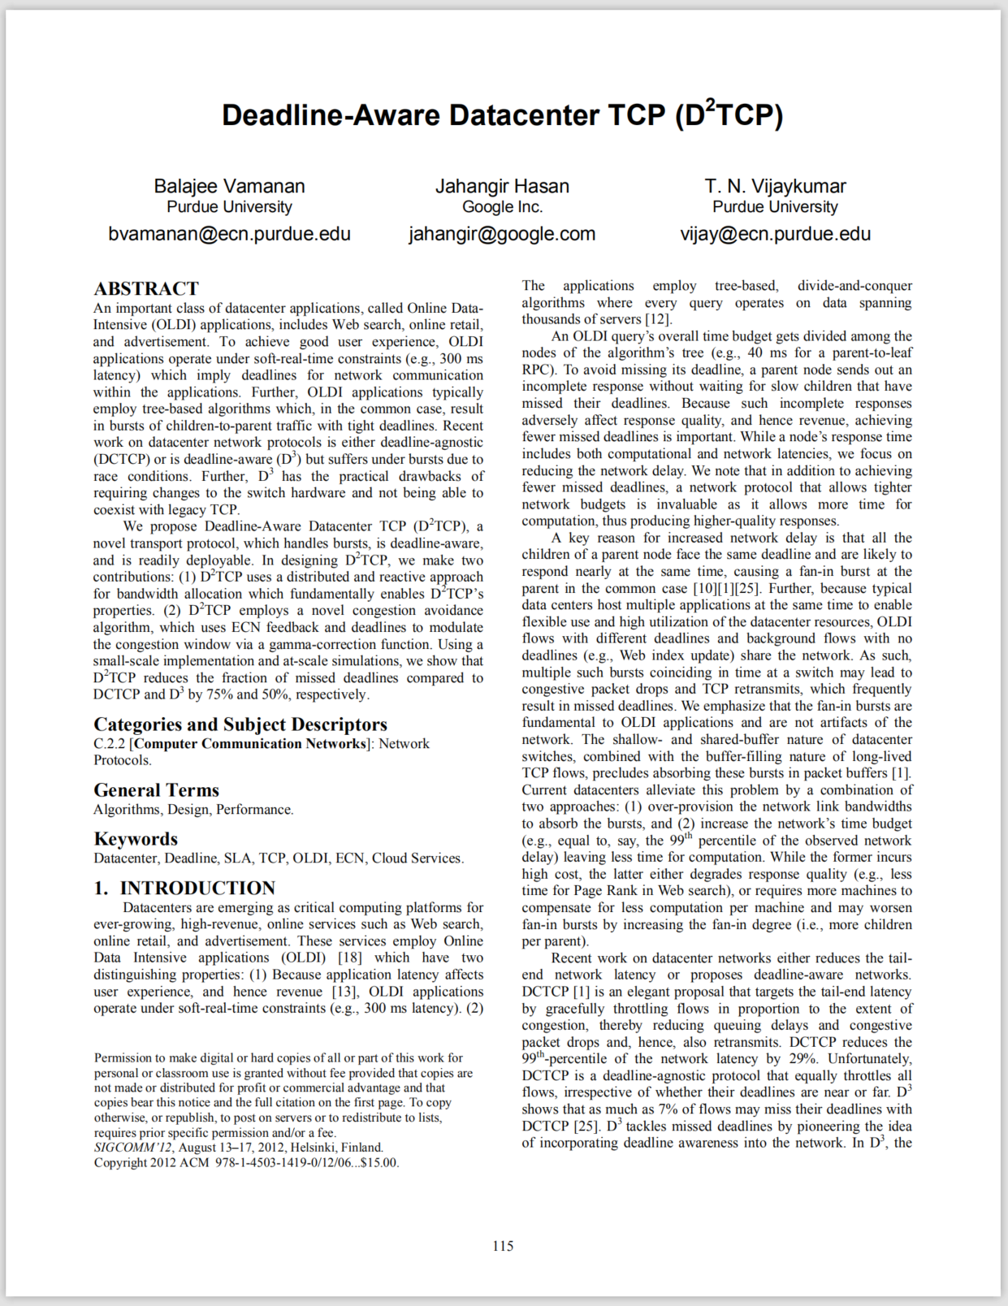
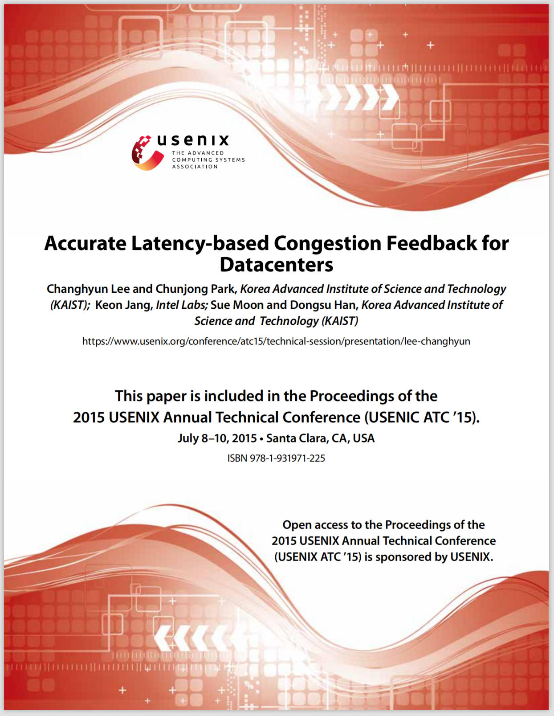
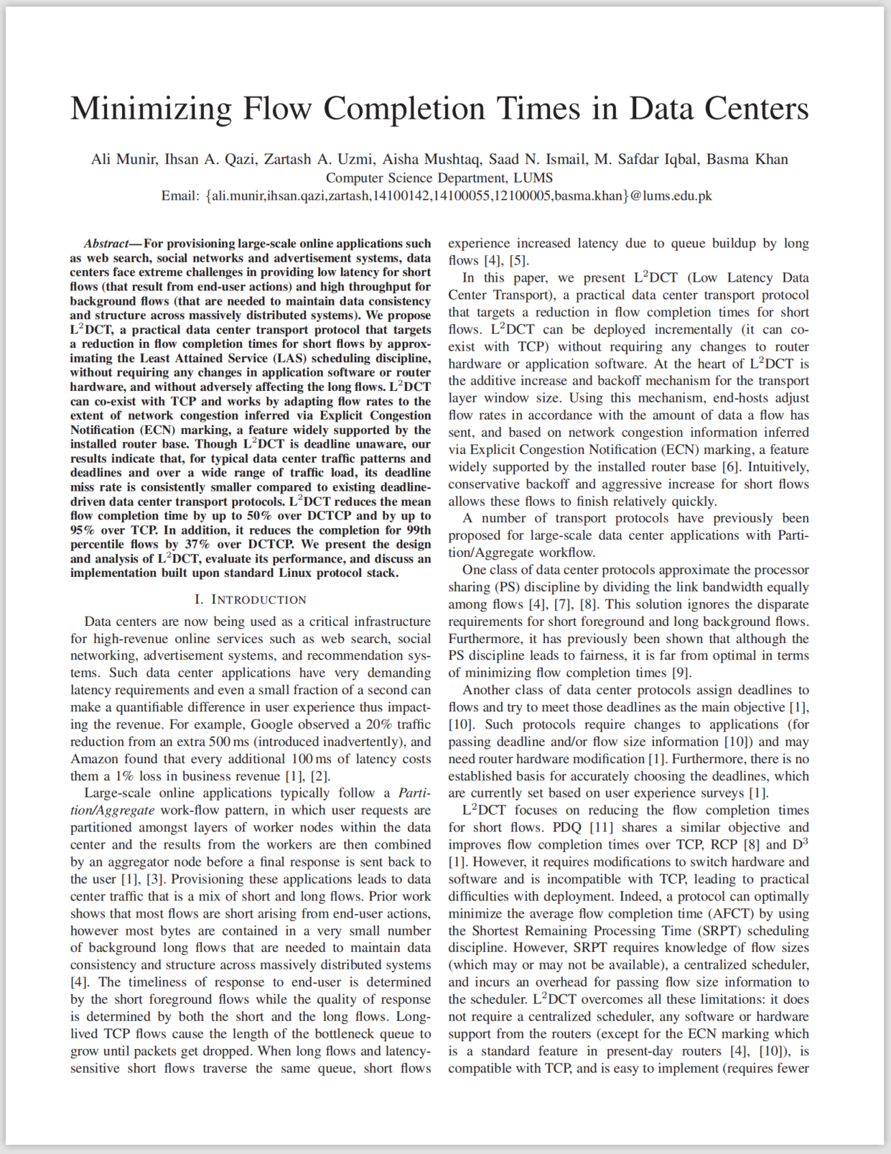
Background
DCTCP
D2TCP
L2DCT
TIMELY
DX
ECN-based
Delay-based
3rd Asia-Pacific Workshop on Networking (APNET 2019) August 17-18 2019, Beijing, China
Notes:
Plenty of end-to-end data center transport protocols have been proposed, mainly including the ECN-based category, such as DCTCP and its variants, and the delay-based category, such as TIMELY and DX. Among of them, DCTCP is most popular in productive data centers due to its good performance and practicability, and has been supported by Microsoft Windows Server 2012 and the Linux kernel after 3.18 version. Some enterprises also start to deploy DCTCP in their private data centers.

Slide 7

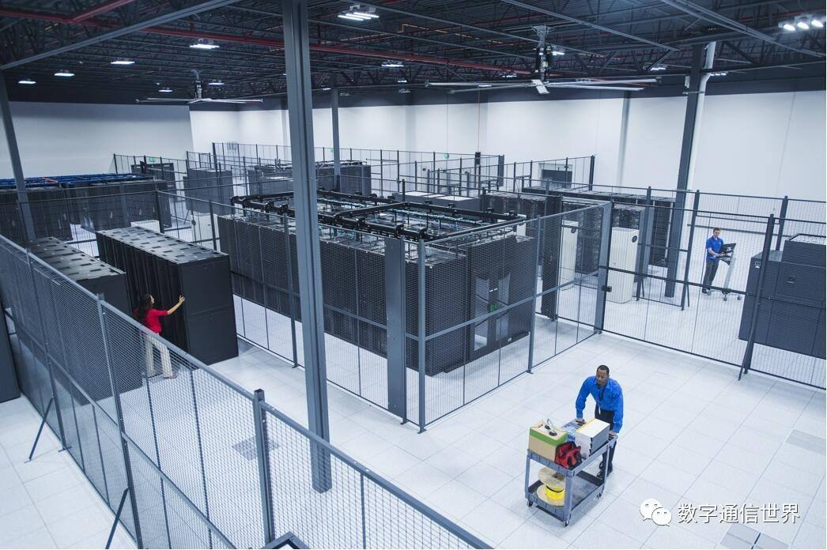
Background
Deploying the new ECN-based TCP is not easy, especially in ...
In Multitenant Datacenters, tenants choose Congestion Control.
Enterprise Datacenters can't upgrade legacy applications.
3rd Asia-Pacific Workshop on Networking (APNET 2019) August 17-18 2019, Beijing, China
Notes:
However, deploying the new ECN-based TCP, such as DCTCP, is not easy. The reasons are that, in multi-tenant datacenters, tenants choose Congestion Control algorithm by themselves, while the enterprise datacenters cannot upgrade legacy applications

Slide 8
Motivation
Coexisting problem
3rd Asia-Pacific Workshop on Networking (APNET 2019) August 17-18 2019, Beijing, China
Notes:
In the following, I’ll elaborate the motivation with an important problem in deployment, namely TCP coexistence

Slide 9
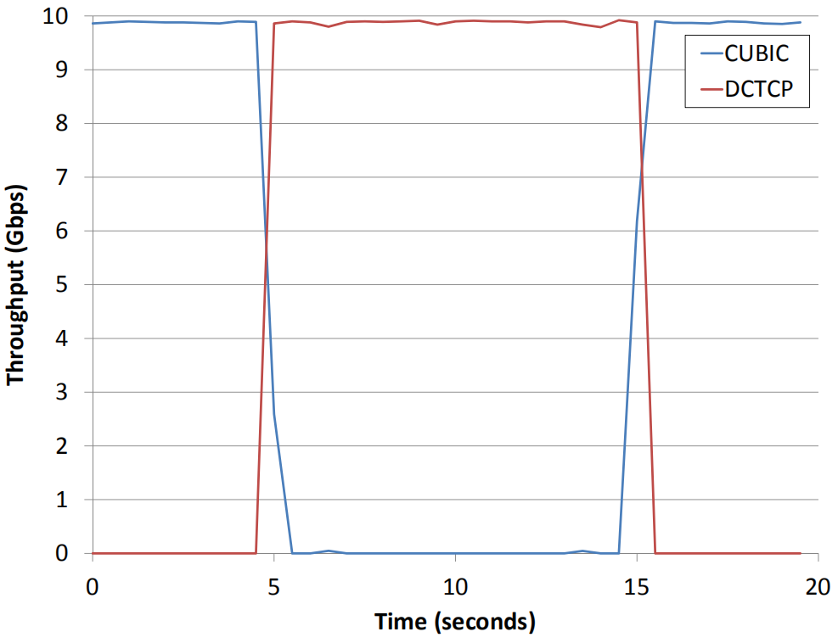
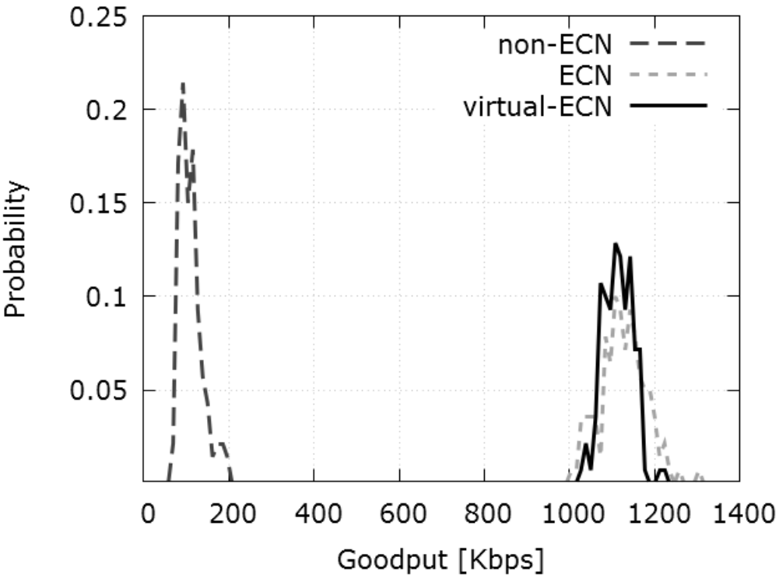
Motivation
Coexisting problem
Glenn Judd, MorGan Stanley,
NSDI'15
Bryce Cronkite-Ratcliff, et al, VMware, Stanford, Technion,SIGCOMM'16
Keqiang He, et al, University of Wisconsin-Madison, IBM Research, IBM, SIGCOMM'16
Deploying the ECN-based TCP will negatively impact the performance of the coexisting ECN-disabled TCPs.
3rd Asia-Pacific Workshop on Networking (APNET 2019) August 17-18 2019, Beijing, China
Notes:
In NSDI 2015, Glenn Judd first raised the coexistence problem in his paper, which is the first published discussion of DCTCP production deployment. After that, two papers in SIGCOMM 2016 again presented this problem and tried to address it by embedding the protocol translation module into the hypervisor in the virtualized multi-tenant datacenters. These works emphasize that deploying the ECN-based TCP will negatively impact the performance of the coexisting ECN-disabled TCPs.

Slide 10
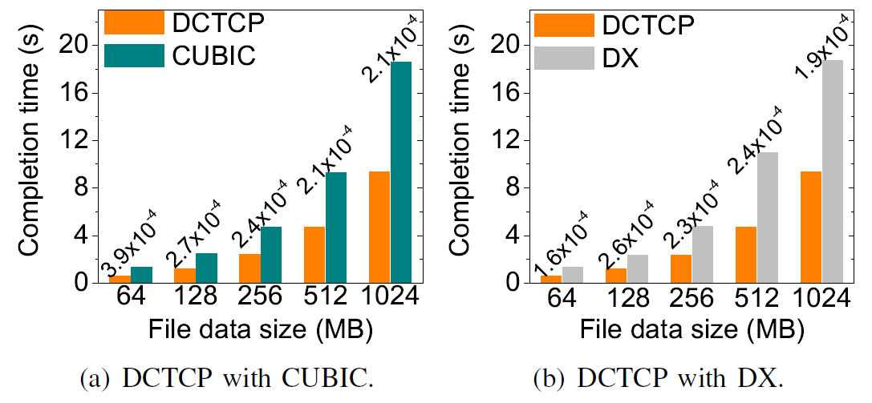
Motivation
Coexisting problem
Proactive dropping vs. Marking
3rd Asia-Pacific Workshop on Networking (APNET 2019) August 17-18 2019, Beijing, China
Notes:
To deeply investigate this problem, we run real implementation in which a host uses HTTP to simultaneously fetch two files from two machines via an ECN-enabled switch. One machine runs DCTCP, and the other one runs CUBIC or DX.
The above two figures show that DCTCP finishes the transfer much faster than both CUBIC and DX. Ideally, if both two senders get the identical bandwidth, they should finish transfer at the same time. However, DCTCP almost takes all the bandwidth during its transmission, seriously damaging the performance of ECN-disabled TCP.

Slide 11
Motivation
Coexisting problem
All packets dropped
ECN Marked & non-ECN Dropped
ECN+CE
RED_min = RED_max = DCTCP_K
ECN+CE
non-ECN
ECN
ECN
All packets queued
non-ECN
non-ECN
Unfairly proactive dropping!
3rd Asia-Pacific Workshop on Networking (APNET 2019) August 17-18 2019, Beijing, China
Notes:
To find out the reason, we show how we deploy DCTCP. Deploying DCTCP needs the ECN capable switch. The popular approach is to simply use RED with both its low and high ECN marking thresholds set as the same value. We just follow this method.
In this figure, the DCTCP marking threshold K is represented by the yellow bar. Below the yellow bar, all packets are queued. Above the yellow bar, the ECN packets are marked, while the non-ECN packets are directly dropped. This is unfair to the ECN-disabled TCPs.

Slide 12
Motivation
Possible remedies
3rd Asia-Pacific Workshop on Networking (APNET 2019) August 17-18 2019, Beijing, China
Notes:
Next, we give several possible remedies to observe if the problem can be solved.

Slide 13
Motivation
Possible remedies
All packets dropped
ECN Marked & non-ECN queued
ECN+CE
RED_min = RED_max = DCTCP_K
ECN+CE
non-ECN
ECN
ECN
All packets queued
non-ECN
non-ECN
Passive dropping vs. Marking
3rd Asia-Pacific Workshop on Networking (APNET 2019) August 17-18 2019, Beijing, China
Notes:
The first intuitive solution is to enforce the passive dropping on the non-ECN packets. That is to say, when the switch queue length is greater than the marking threshold, the non-ECN packets are still queued unless the switch buffer is overflowed.

Slide 14
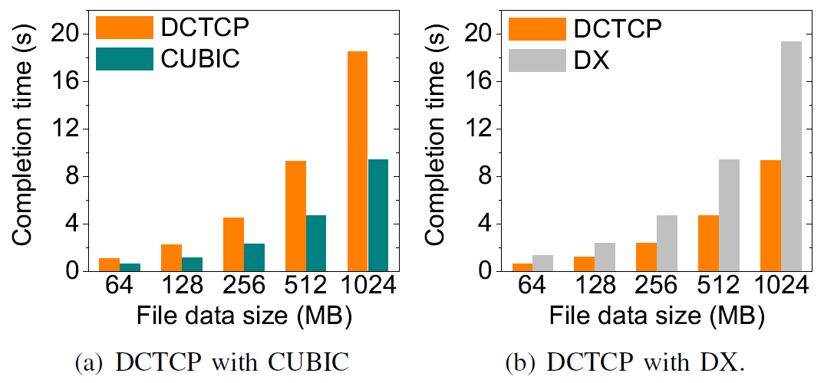
Motivation
Possible remedies
Unfairness still exists!
Unfairness still exists!
3rd Asia-Pacific Workshop on Networking (APNET 2019) August 17-18 2019, Beijing, China
Notes:
However, after we redo the previous test, the result shows that the unfairness still exists. In the left figure, the situation is totally reversed. CUBIC wins the competition in a landslide since CUBIC does not retreat until perceiving the packet loss, making it tend to fill up the space of switch buffer. Adversely, DCTCP retreats much more earlier since the marking threshold is generally much smaller than the switch buffer size to provide low queuing delay.
In contrast, DX is still too weak since it is very sensitive to queuing delay due to its design goal of achieving zero-queuing, which in turn causes the much earlier backoff operation compared with DCTCP.

Slide 15
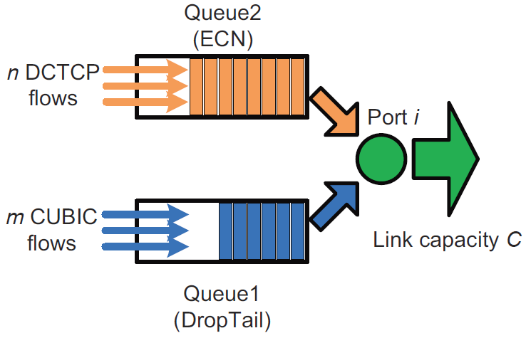
Motivation
Possible remedies
Traffic isolating
The switch needs to consider how to allocate bandwidth for each queue in real-time.
3rd Asia-Pacific Workshop on Networking (APNET 2019) August 17-18 2019, Beijing, China
Notes:
The second straightforward method is running different queue polices in switch for the coexisting protocols. This is a good way to provide the inter-protocol fairness, but hard to guarantee the flow-level fairness. The reason is that the switch needs to monitor the number of flows in each queue of each port in real time to achieve the fair bandwidth allocation at the flow-level, which introduces high implementation overhead on switch.

Slide 16
Motivation
Possible remedies
All DCTCP packets dropped
All CUBIC packets dropped
CUBIC(RED_max)
All DCTCP packets marked
ECN+CE
ECN+CE
DCTCP(RED_min )=
DCTCP(RED_max)=
DCTCP_K
CUBIC packets are selectively dropped
non-ECN
ECN
CUBIC(RED_min)
All DCTCP packets queued
ECN
non-ECN
All CUBIC packets queued
non-ECN
WRED mitigating
3rd Asia-Pacific Workshop on Networking (APNET 2019) August 17-18 2019, Beijing, China
Notes:
Additionally, we also wonder if the classic WRED can resolve the problem. In principle, WRED selectively drops packets based on priority. Packets with the high priority are less likely dropped than packets with the lower priority. We assign different values to the low and high dropping thresholds for CUBIC. Below the lower green bar, the CUBIC packets are queued. Between two green bars, the CUBIC packets are selectively dropped. Above the higher green bar, the CUBIC packets are directly dropped.

Slide 17
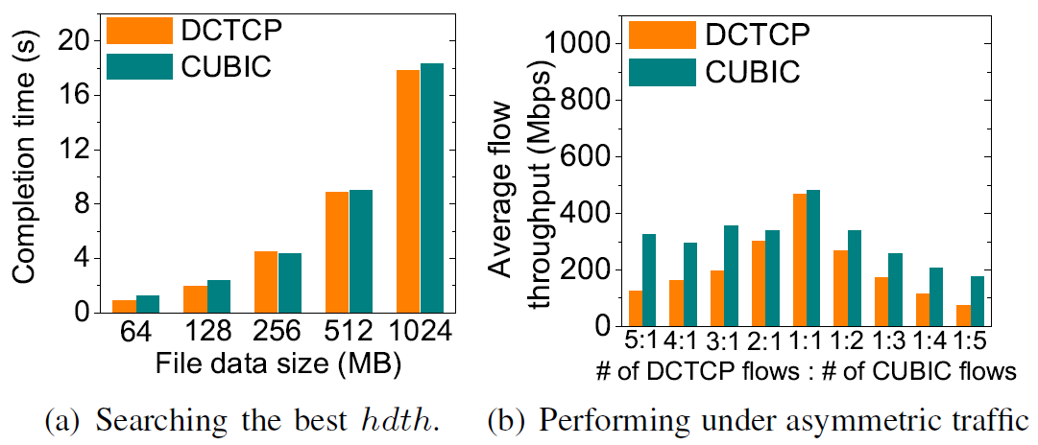
Motivation
Possible remedies
The static configuration of threholds can not adapt to the traffic variation in real-time.
3rd Asia-Pacific Workshop on Networking (APNET 2019) August 17-18 2019, Beijing, China
Notes:
After many attempts, we find out the best threshold values for CUBIC, which causes the very close completion time in each case, as shown in the left figure. Nonetheless, since each protocol sends only one flow, it is unclear if the threshold setting also works under the asymmetric traffic, in which the numbers of CUBIC and DCTCP flows are not equal. Unfortunately, the answer is no. In the right figure, we find that the flow-level fairness is not satisfied across almost all the cases, except the symmetric one, showing that the static configuration of thresholds can not adapt to the traffic variation in real-time.

Slide 18
Motivation
Possible remedies
VM
VM
VM
VM
Hypervisor
(translation module)
Hypervisor
(translation module)
Datacenter Network
Hypervisor intervening
How to accurately translate the underlying congestion signal into the one that the VM's TCP stack can understand?
How to leave the control logic of VM's TCP undisturbed?
3rd Asia-Pacific Workshop on Networking (APNET 2019) August 17-18 2019, Beijing, China
Notes:
Recent solutions such as AC/DC and vCC effectively address the coexistence problem by embedding the protocol translation module into the hypervisor. They interrupt the normal end-to-end data transfer of the tenant’s TCP. Before entering the network, the mixed traffic must be shaped to a kind of isomorphic traffic. Therefore, there exists only one type of traffic in the underlying network, thus avoiding the coexistence problem perfectly.
Nevertheless, for the consideration of elasticity and flexibility, another problem also comes together: How to accurately translate the underlying congestion signal into the one that the VM's TCP can understand? For example, if DCTCP handles the data transmission in the physical network, how to transform the mark signal to the packet loss or delay signal at VM level? Besides, the processing delay in hypervisor can greatly increase the transfer latency, which probably confuses the delay-based protocol. Therefore, it is hard for the hypervisor-based methods to guarantee fairness without negative impacts on the VM’s TCP.

Slide 19
Motivation
Objectives
1) amending the ECN-supported AQM at switch to avoid the unfairly proactive packet-dropping of non-ECN traffic;
2) finding a way to mitigate the competitiveness difference between data center TCPs without modifying the tenant’s TCP stack;
3) leaving the normal operations of the data center TCPs undisturbed.
3rd Asia-Pacific Workshop on Networking (APNET 2019) August 17-18 2019, Beijing, China
Notes:
Based the above observations, we conclude the design objectives are as the following:

Slide 20
Approach
3rd Asia-Pacific Workshop on Networking (APNET 2019) August 17-18 2019, Beijing, China
Notes:
Next, we show our approach.

Slide 21
Approach
Basic idea
All ECN packets dropped
All non-ECN packets dropped
ECN+CE
Dropping threshold
All ECN packets marked
non-ECN
ECN+CE
non-ECN
Marking threshold
ECN
All non-ECN packets queued
ECN
All ECN packets queued
non-ECN
non-ECN
3rd Asia-Pacific Workshop on Networking (APNET 2019) August 17-18 2019, Beijing, China
Notes:
We first present the basic idea. The value of marking threshold decides both the time at which the sender starts to retreat, and what extent the sending rate should be reduced. In other words, we can increase or decrease the value of marking threshold to make the ECN-enabled TCP become more or less aggressive. Similarly, the packet dropping threshold indicates the number of non-ECN packets that can be queued at the switch buffer, which enlightens us that varying its value can adjust the competitiveness of ECN-disabled TCP.

Slide 22
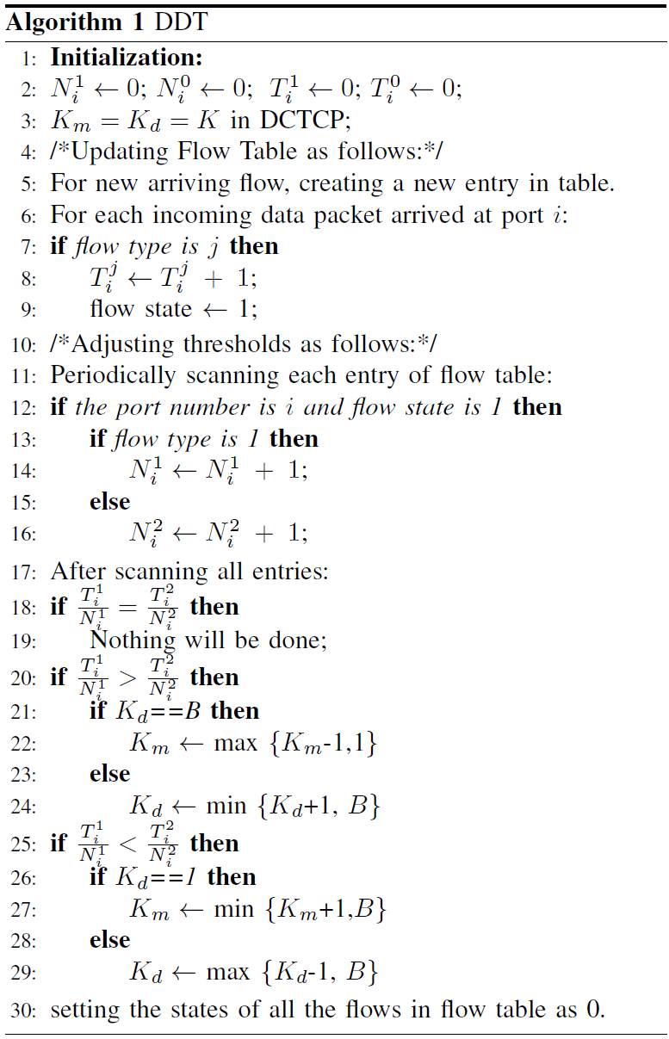
Approach
DDT
obtaining the ratio of active flows belong to each type of traffic
automatically adjusting two thresholds to match the obtained flow ratio
3rd Asia-Pacific Workshop on Networking (APNET 2019) August 17-18 2019, Beijing, China
Notes:
We propose DDT to achieve the flow-level fairness when the heterogeneous TCP traffic coexists. The switch queue has two thresholds including the ECN marking threshold, and the packet dropping threshold. Moreover, the switch classifies the protocol types of active flows, and measures the number of flows in each type. Then, the thresholds are adaptively regulated in a linear way to control the competitiveness of coexisting TCPs so that each of them can share bandwidth fairly.

Slide 23
Evaluation
3rd Asia-Pacific Workshop on Networking (APNET 2019) August 17-18 2019, Beijing, China
Notes:
Next, we evaluate the performance of DDT.

Slide 24
Evaluation
Test scenario
1) Small-scaled real implementation
There are four machines (A to D), each of which has Intel i7 4.0Ghz CPU and 16GB MEMORY. Machine A (running DCTCP) and machine B (running CUBIC or DX) connect to machine D (ECN enabled) with three 1Gbps links via machine C, which is modified to work as an ECN-enabled switch with an Intel I350-T4 (four 1Gbps ports) Ethernet card.
2) Large-scaled NS2 simulation
We use the popular leaf-spine topology with 10 leaf switches and 10 spine switches.
Each leaf switch interconnects with 20 hosts. Besides, the link capacity, basic round trip time, buffer size of switches and ECN marking threshold are 1Gbps, 100µs, 200 packets
and 20 packets, respectively. We use two realistic workloads (i.e., web-searching and data-mining), which follow the heavy-tailed distribution.
3rd Asia-Pacific Workshop on Networking (APNET 2019) August 17-18 2019, Beijing, China
Notes:
The test scenario includes the small-scaled real implementation and the large-scaled NS2 simulation.

Slide 25
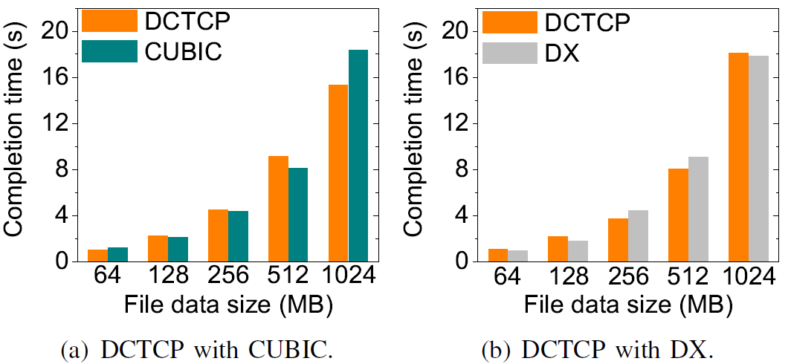
Evaluation
Small-scaled real implementations
Motivation tests
3rd Asia-Pacific Workshop on Networking (APNET 2019) August 17-18 2019, Beijing, China
Notes:
We deploy DDT and redo the tests in the motivation part. In the above figures, with the help of DDT, the coexisting protocols obtain the similar bandwidths and finish the file transfer almost at the same time, showing that the fairness is well guaranteed.

Slide 26
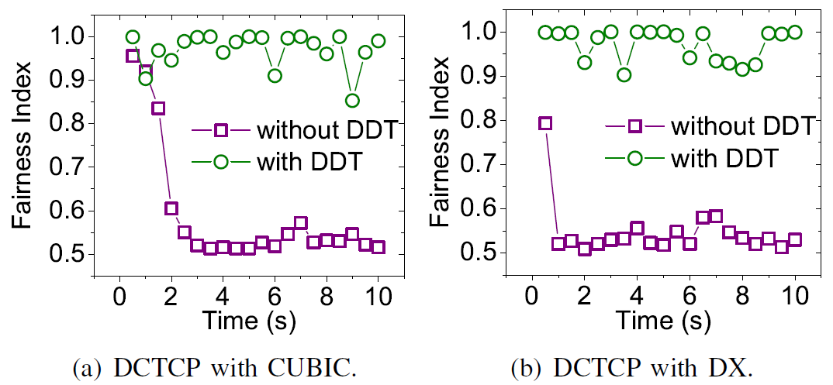
Evaluation
Small-scaled real implementations
Jain’s fairness index
3rd Asia-Pacific Workshop on Networking (APNET 2019) August 17-18 2019, Beijing, China
Notes:
As to the test of Jain’s fairness index, we find that the fairness index without DDT is quite low in both two figures. In contrast, after introducing DDT, the fairness index is never lower than 0.8.

Slide 27
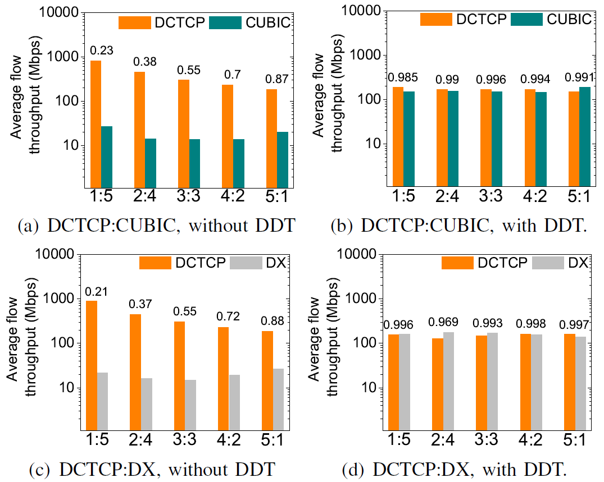
Evaluation
Asymmetry tests
Small-scaled real implementations
3rd Asia-Pacific Workshop on Networking (APNET 2019) August 17-18 2019, Beijing, China
Notes:
We also investigate if DDT can adapt to the asymmetric traffic. From the figures, we can find that the situation is totally changed after introducing DDT. Both the identical average flow throughput and the higher fairness indexes above the bars show that the flow-level fairness is good.

Slide 28
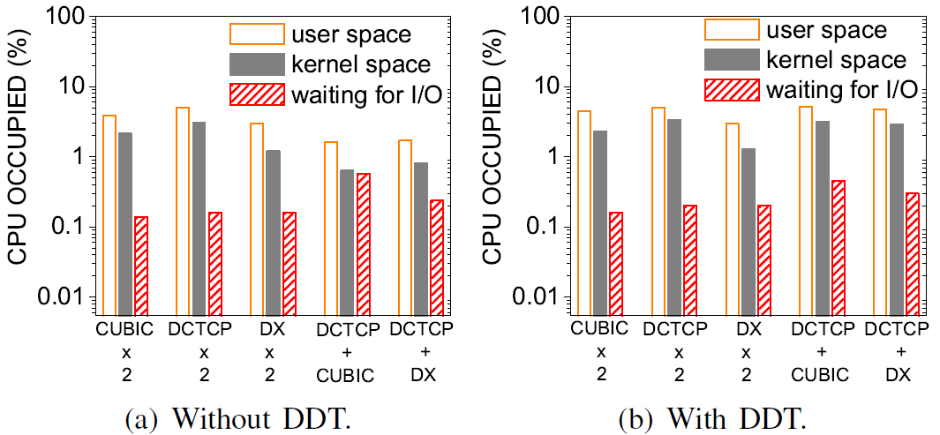
Evaluation
Small-scaled real implementations
Overhead
3rd Asia-Pacific Workshop on Networking (APNET 2019) August 17-18 2019, Beijing, China
Notes:
Since DDT needs to monitor the per-flow state at switch, the implementation overhead should be considered particularly. Our preliminary prototype switch is a Linux kernel-patched X86 machine, hence we observe the overhead of operating system. Overall, since DDT does not work when the heterogeneous traffic is absent, the additional overhead of introducing DDT is trivial.

Slide 29
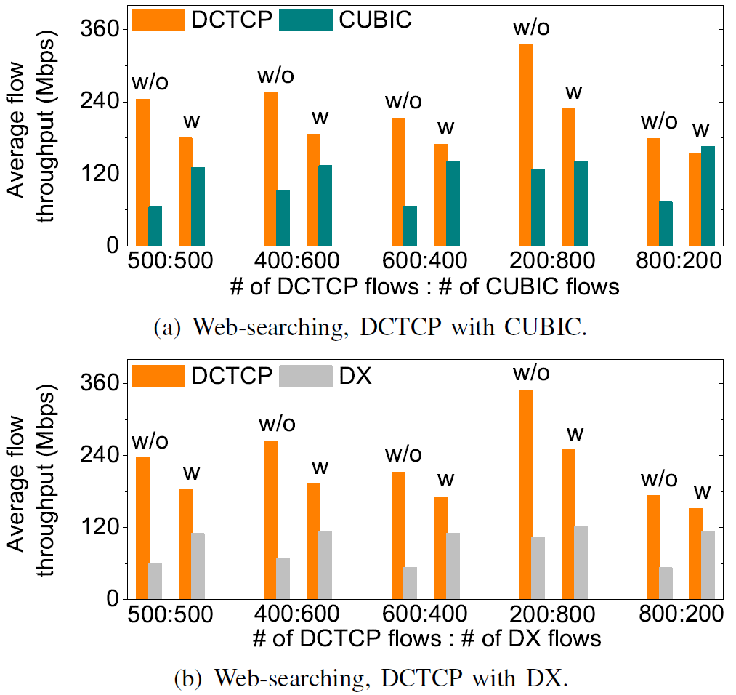
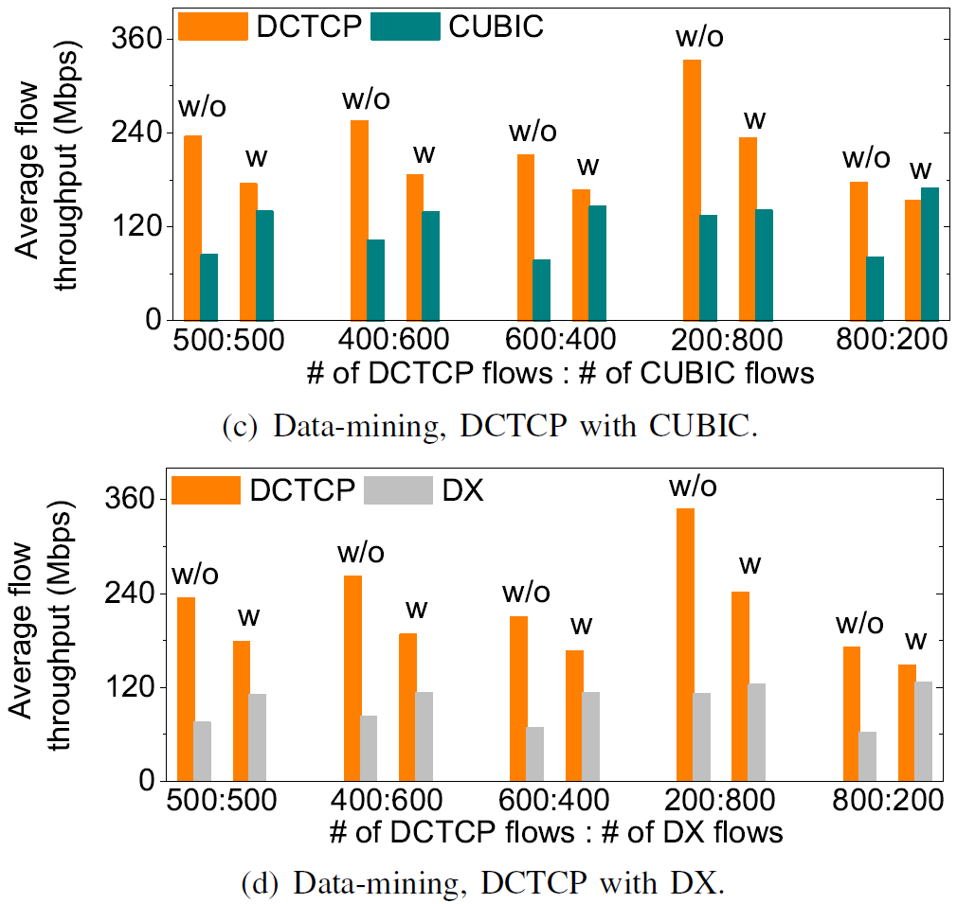
Evaluation
Large-scaled simulations
Flow-level fairness
3rd Asia-Pacific Workshop on Networking (APNET 2019) August 17-18 2019, Beijing, China
Notes:
Next, we run large-scaled NS2 simulation. We first evaluate the flow-level fairness under the asymmetric traffic involving 1000 heterogeneous flows. In the above figures, the average flow throughputs of the ECN-disabled TCPs with DDT move closer to those of DCTCP. In fact, the performance gain can increase if the coexistence happens more frequently. In our tests, since the destination of each flow is randomly generated, the coexistence is uncontrollable. Therefore, we believe that the performance of DDT can become more promising.

Slide 30
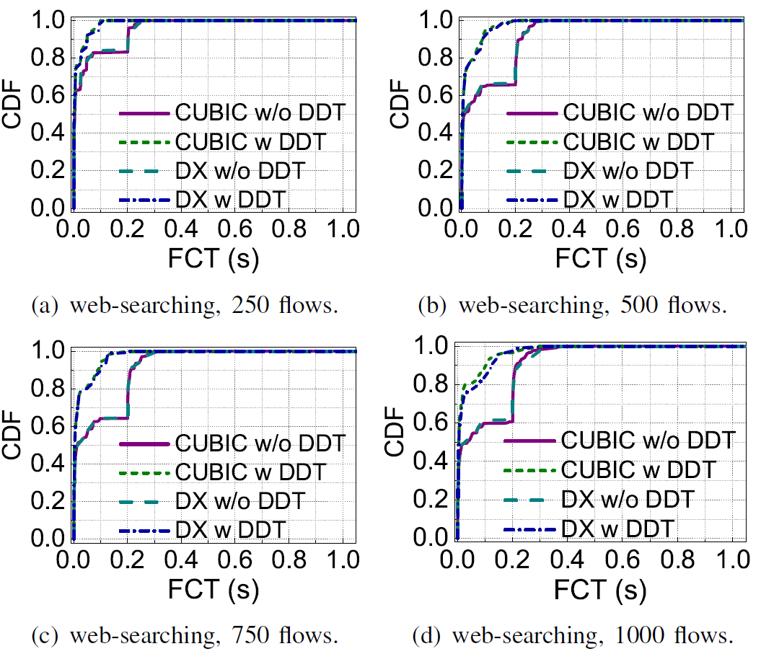
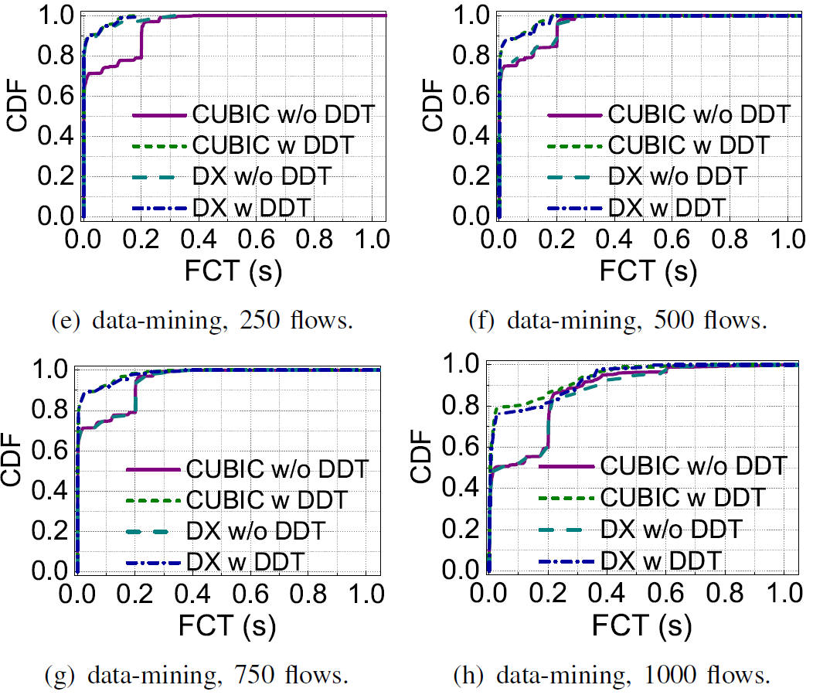
Evaluation
Large-scaled simulations
Flow-level transmission performance
3rd Asia-Pacific Workshop on Networking (APNET 2019) August 17-18 2019, Beijing, China
Notes:
Since DDT corrects the abnormal packet loss of the original ECN scheme, we also wonder if DDT can improve the flow-level transmission performance. From the above figures, we can observe that the improvement gets better as increasing the network load.

Slide 31
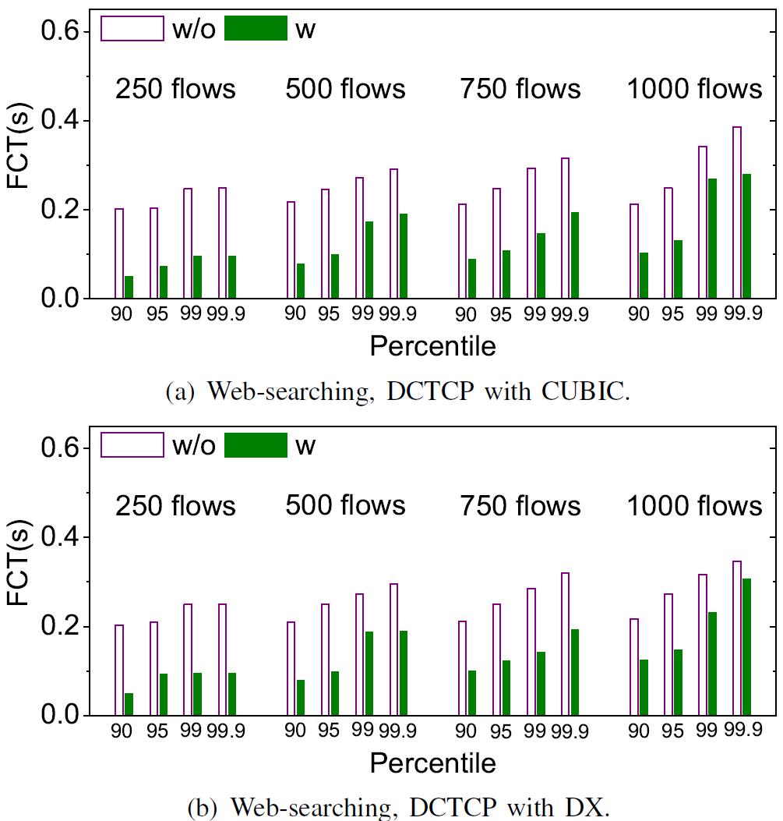
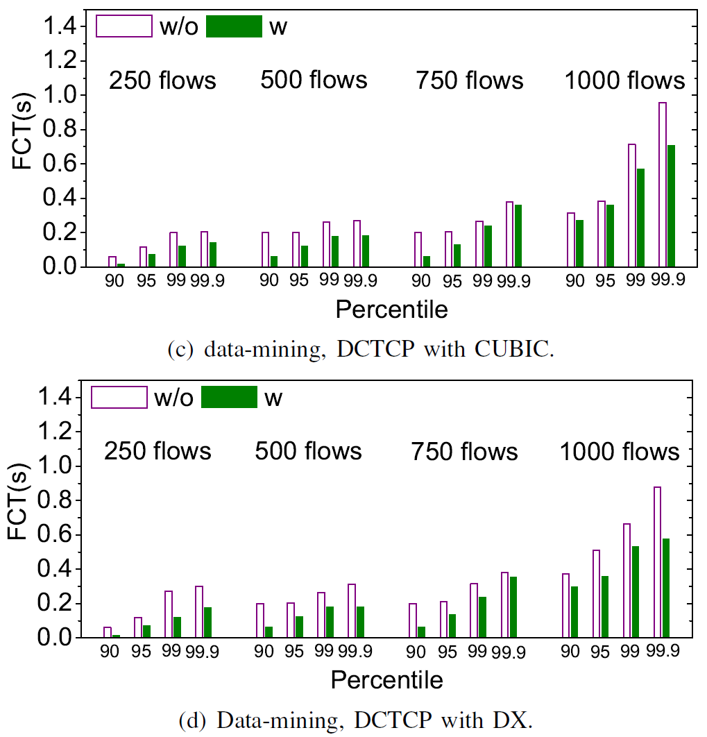
Evaluation
Large-scaled simulations
Tail flow completion time
3rd Asia-Pacific Workshop on Networking (APNET 2019) August 17-18 2019, Beijing, China
Notes:
Besides, the FCT percentiles are also significantly improved almost across all the cases.

Slide 32
Conclusion
We design and implement DDT, an AQM algorithm to mitigate the competitiveness difference of current TCP variants in data centers. By adaptively tuning the distance between the ECN marking threshold and the packet dropping threshold, DDT helps the ECN and non-ECN TCP traffic coexist fairly, thus achieving the flow-level fairness.
3rd Asia-Pacific Workshop on Networking (APNET 2019) August 17-18 2019, Beijing, China
Notes:
Finally, we conclude our work.

Slide 33
Conclusion
Future work:
1) helping DDT identify more types of heterogeneous TCP traffic;
2) finding a more effective way to quickly obtain the correct values of dual dynamic thresholds.
3rd Asia-Pacific Workshop on Networking (APNET 2019) August 17-18 2019, Beijing, China
Notes:
Our future work includes:

Slide 34

Thanks!
Q&A
Notes:
Thanks for everyone.

